Slide 1
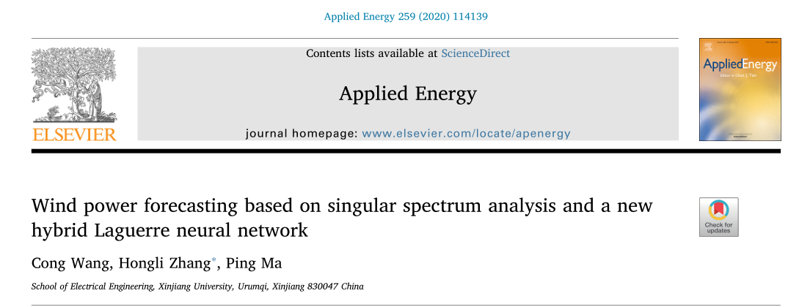
汇报人：张浩田

Slide 2
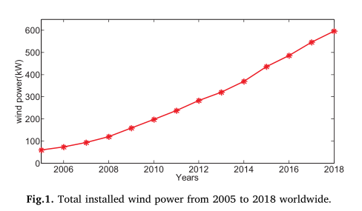

Slide 3
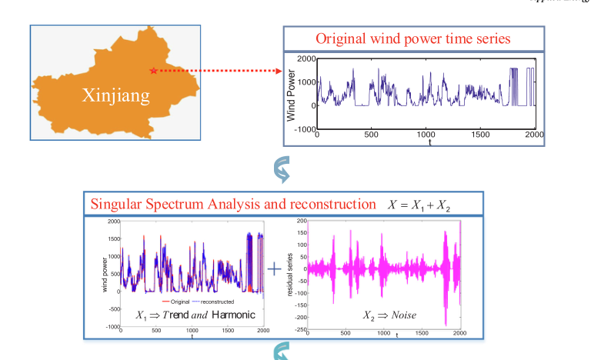

Slide 4


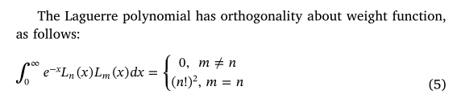

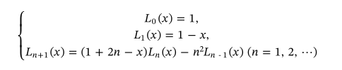

Laguerre polynomial
new Laguerre polynomial

Slide 5
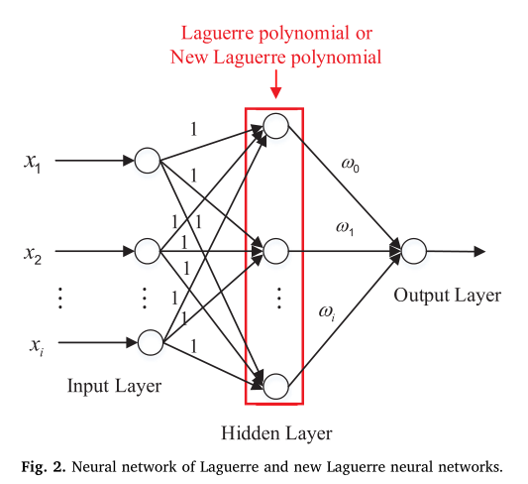

Slide 6
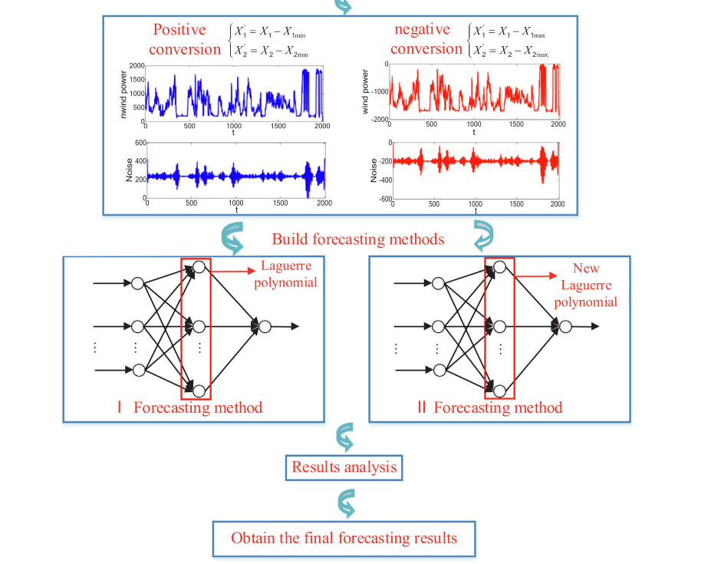
结合两种正交基神经网络的优点，构造了一种混合神经网络。
首先，通过数据转换将风电机组调整到非正轴和正轴。
其次，采用正交基神经网络对风电序列进行预测。
第三，通过逆转换得到两个模型的结果。
最后，将预测模型的结果进行组合和平均，并输出最终的预测结果。

Slide 7
结合两种正交基神经网络的优点，构造了一种混合神经网络。
首先，通过数据转换将风电机组调整到非正轴和正轴。
其次，采用正交基神经网络对风电序列进行预测。
第三，通过逆转换得到两个模型的结果。
最后，将预测模型的结果进行组合和平均，并输出最终的预测结果。

Slide 8

状态转移算法（2011）
该算法有四个算子[28]，即旋转变换（RT）、平移运算（TT）、展开变换（ET）、axesion变换（AT）和原对偶（PD）方法。

Slide 9

算法改进
步骤1：使用局部最优判别机制判断结果是否接近局部最优。设STA的适应度方差为
方差越小，算法的收敛程度越高。
如果适应度方差小于α，理论最优值优于当前适应度最优值，算法处于局部最优。α是一个正值，它是根据优化问题设置的。

Slide 10

算法改进
第二步：提出了一种基于反对变换（OT）学习的局部优化算法。

Slide 11
算法改进
第二步：提出了一种基于反对变换（OT）学习的局部优化算法。

Slide 12
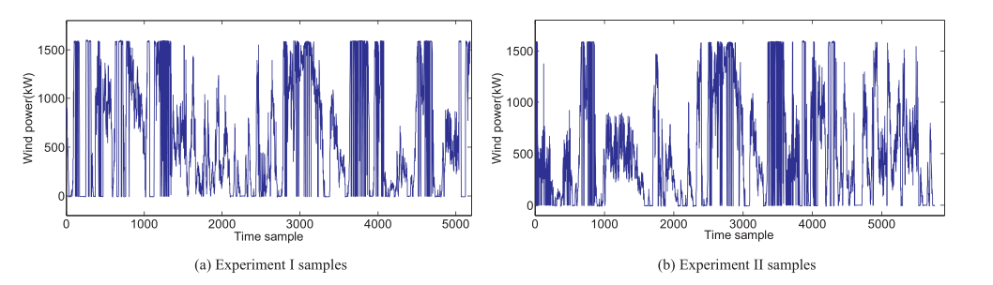
实验及结果
选取了中国新疆某风电场的两个数据集，实验一收集了2014年全年的风电数据。考虑季节等因素，选取每月5、15、25日为样本。采用10分钟风电输出数据集的小时平均值进行分析。实验二，收集了2016年全年的风电数据。考虑到各种因素，如季节，数据集涵盖1月1日至10日、4月、7月和10月。训练集涵盖了四个月的第一天到第八天，其余的作为测试集。

Slide 13
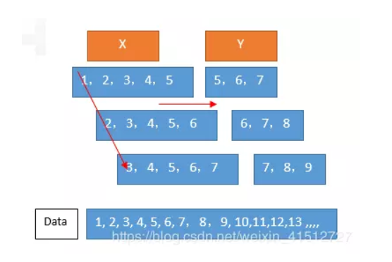
多步预测

Slide 14
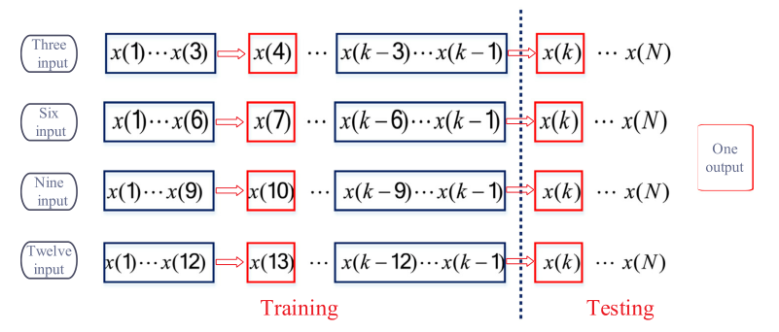
多步预测
输入长度为i＝3、6、9和12的预测策略也被应用于评估所提议模式的性能，采用多步预测机制

Slide 15
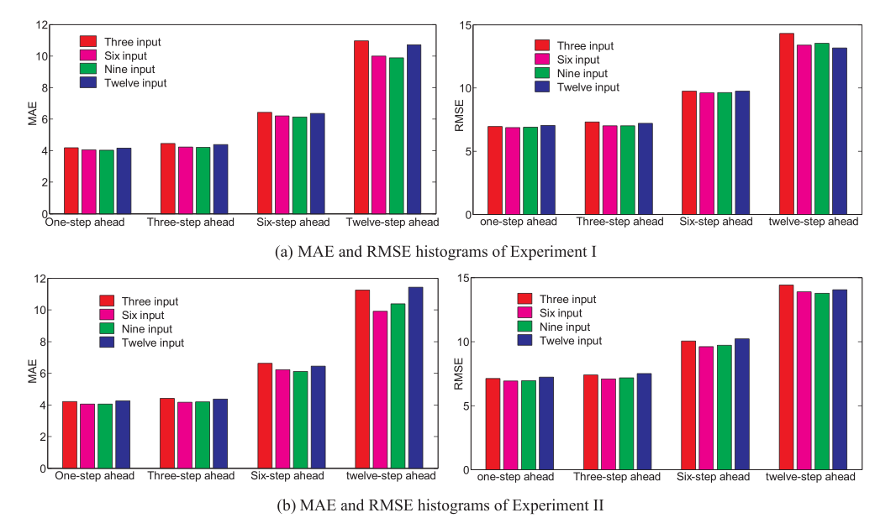
多步预测

Slide 16
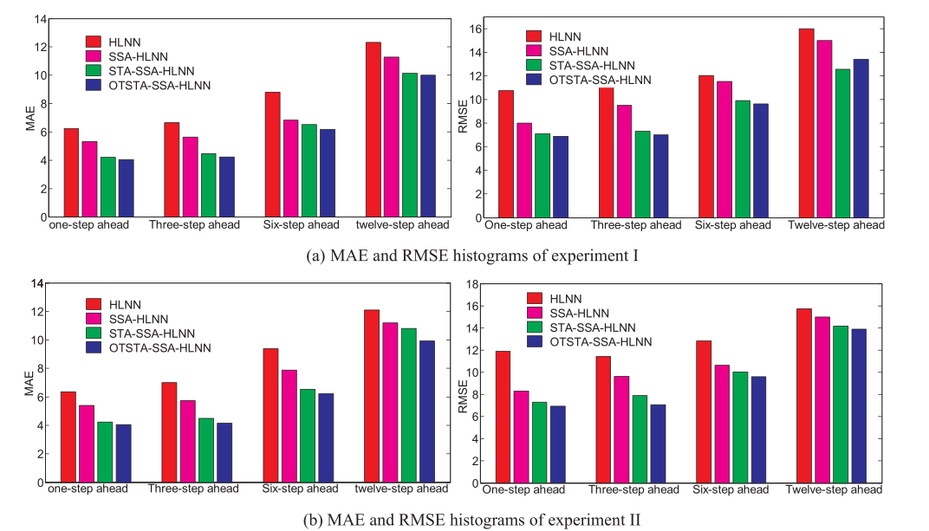
多步预测

Slide 17
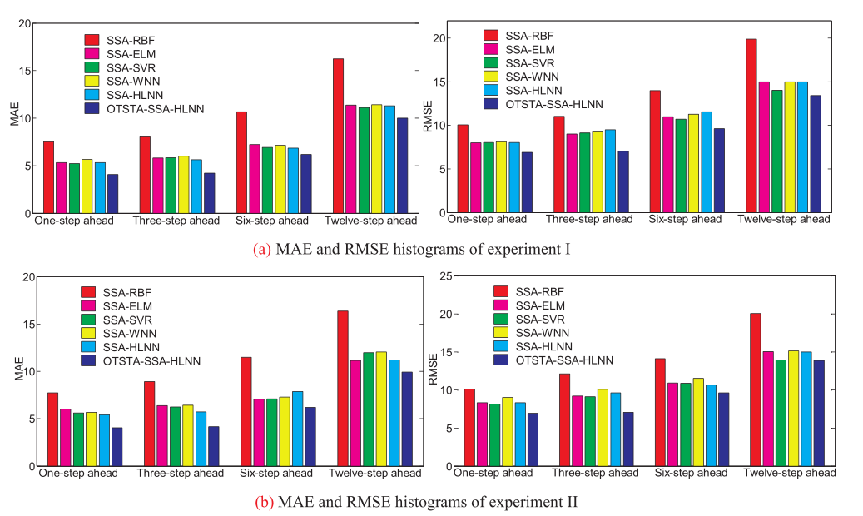
多步预测

Slide 18
Thank you

Slide 19
YOU CAN ALSO SPLIT YOUR CONTENT
White
Is the color of milk and fresh snow, the color produced by the combination of all the colors of the visible spectrum.
Black
Is the color of coal, ebony, and of outer space. It is the darkest color, the result of the absence of or complete absorption of light.

Slide 20
IN 2 OR 3 COLUMNS
Yellow
Is the color of gold, butter and ripe lemons. In the spectrum of visible light, yellow is found between green and orange.
Blue
Is the colour of the clear sky and the deep sea. It is located between violet and green on the optical spectrum.
Red
Is the color of blood, and because of this it has historically been associated with sacrifice, danger and courage.

Slide 21
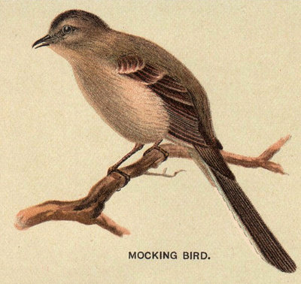
A PICTURE IS WORTH A THOUSAND WORDS
A complex idea can be conveyed with just a single still image, namely making it possible to absorb large amounts of data quickly.

Slide 22
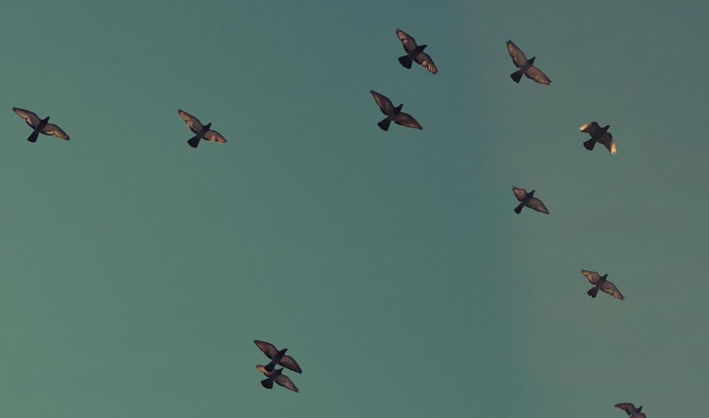
Want big impact?
USE BIG IMAGE

Slide 23
USE CHARTS TO EXPLAIN YOUR IDEAS
White
Gray
Black

Slide 24
AND TABLES TO COMPARE DATA
 | A | B | C
Yellow | 10 | 20 | 7
Blue | 30 | 15 | 10
Orange | 5 | 24 | 16

Slide 25
MAPS
our office

Slide 26
89,526,124
Whoa! That’s a big number, aren’t you proud?

Slide 27
89,526,124$
185,244 users
100%
That’s a lot of money
And a lot of users
Total success!

Slide 28
OUR PROCESS IS EASY
first
second
last

Slide 29
LET’S REVIEW SOME CONCEPTS
Yellow
Is the color of gold, butter and ripe lemons. In the spectrum of visible light, yellow is found between green and orange.
Blue
Is the colour of the clear sky and the deep sea. It is located between violet and green on the optical spectrum.
Red
Is the color of blood, and because of this it has historically been associated with sacrifice, danger and courage.
Yellow
Is the color of gold, butter and ripe lemons. In the spectrum of visible light, yellow is found between green and orange.
Blue
Is the colour of the clear sky and the deep sea. It is located between violet and green on the optical spectrum.
Red
Is the color of blood, and because of this it has historically been associated with sacrifice, danger and courage.

Slide 30
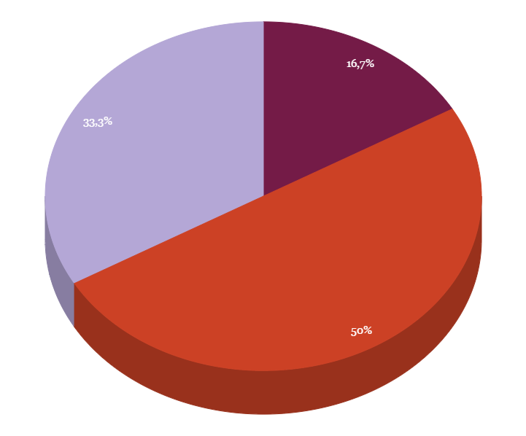
You can insert graphs from Google Sheets

Slide 31
ANDROID PROJECT
Show and explain your web, app or software projects using these gadget templates.
Place your screenshot here

Slide 32
iPHONE PROJECT
Show and explain your web, app or software projects using these gadget templates.
Place your screenshot here

Slide 33
TABLET PROJECT
Show and explain your web, app or software projects using these gadget templates.
Place your screenshot here

Slide 34
DESKTOP PROJECT
Show and explain your web, app or software projects using these gadget templates.
Place your screenshot here

Slide 35

THANKS!
Any questions?
You can find me at @username & user@mail.me

Slide 36
CREDITS
Special thanks to all the people who made and released these awesome resources for free:
Presentation template by SlidesCarnival
Photographs by Unsplash

Slide 37
PRESENTATION DESIGN
This presentation uses the following typographies and colors:
Titles: Oswald
Body copy: Tinos
You can download the fonts on these pages:
https://www.fontsquirrel.com/fonts/oswald · https://www.fontsquirrel.com/fonts/tinos
You don’t need to keep this slide in your presentation. It’s only here to serve you as a design guide if you need to create new slides or download the fonts to edit the presentation in PowerPoint®

Slide 38
SlidesCarnival icons are editable shapes.
This means that you can:
Resize them without losing quality.
Change fill color and opacity.
Isn’t that nice? :)
Examples:

Slide 39
😉
Now you can use any emoji as an icon!
And of course it resizes without losing quality and you can change the color.
How? Follow Google instructions https://twitter.com/googledocs/status/730087240156643328
✋👆👉👍👤👦👧👨👩👪💃🏃💑❤😂😉😋😒😭👶😸🐟🍒🍔💣📌📖🔨🎃🎈🎨🏈🏰🌏🔌🔑 and many more...

